Slide 2
Ballot Box Basics
Amending the Pennsylvania Constitution
October 3, 2022

Slide 3
How to amend the Pennsylvania Constitution
§ 1. Proposal of amendments by the General Assembly and their adoption.
Amendments to this Constitution may be proposed in the Senate or House of Representatives; and if the same shall be agreed to by a majority of the members elected to each House, such proposed amendment or amendments shall be entered on their journals with the yeas and nays taken thereon, and the Secretary of the Commonwealth shall cause the same to be published three months before the next general election, in at least two newspapers in every county in which such newspapers shall be published; and if, in the General Assembly next afterwards chosen, such proposed amendment or amendments shall be agreed to by a majority of the members elected to each House, the Secretary of the Commonwealth shall cause the same again to be published in the manner aforesaid; and such proposed amendment or amendments shall be submitted to the qualified electors of the State in such manner, and at such time at least three months after being so agreed to by the two Houses, as the General Assembly shall prescribe; and, if such amendment or amendments shall be approved by a majority of those voting thereon, such amendment or amendments shall become a part of the Constitution; but no amendment or amendments shall be submitted oftener than once in five years. When two or more amendments shall be submitted they shall be voted upon separately.
(a) In the event a major emergency threatens or is about to threaten the Commonwealth and if the safety or welfare of the Commonwealth requires prompt amendment of this Constitution, such amendments to this Constitution may be proposed in the Senate or House of Representatives at any regular or special session of the General Assembly, and if agreed to by at least two-thirds of the members elected to each House, a proposed amendment shall be entered on the journal of each House with the yeas and nays taken thereon and the official in charge of statewide elections shall promptly publish such proposed amendment in at least two newspapers in every county in which such newspapers are published. Such amendment shall then be submitted to the qualified electors of the Commonwealth in such manner, and at such time, at least one month after being agreed to by both Houses as the General Assembly prescribes.
(b) If an emergency amendment is approved by a majority of the qualified electors voting thereon, it shall become part of this Constitution. When two or more emergency amendments are submitted they shall be voted on separately.

Slide 4
Wait, what?
Pennsylvania has biennial (two year) “sessions” - each two-year period is a single session of the legislature.
The exact same language has to pass both the House and Senate, in each of two sessions.
Once the legislature passes it, it has to be advertised in a newspaper in each county, three times.
After it has passed twice, then it goes to the voters.
A few notes:
Proposals to change the Constitution are resolutions, not legislation, and are not subject to a veto.
When something is placed on the ballot (which election) has potential to affect whether or not it passes.
Off year elections have lower turnout, fewer voters voting
While Independents are allowed to vote on ballot measures even in primaries, many don’t participate in primaries since they can’t vote for the candidates
Notes:
Terrie not using slides during Welcome

Slide 5
Passes House & Senate in a legislative session
Is advertised
Passes House & Senate in a 2nd legislative session
90 days
Goes to voters
Notes:
Terrie not using slides during Welcome

Slide 6
It goes to the voters – is that bad?
Totally fine – WHEN the issue is appropriate for a change in the Constitution
E.g. eliminating the election for Lt Governor (whether you agree or not) is a change in the power of the people, and therefore reasonable
Asking voters if they want to make a fundamental change to their own power or re-assign it is okay
Should not be holding ballot measures to take away/prohibit or ban a right
BUT!
Many recent proposals are more appropriate for legislation (i.e. Voter ID)
Efforts to avoid the veto are not a good reason to go to Constitutional Amendment route.
The timing has become an issue, targeting low-turnout elections is about gamesmanship, not good decision making
Since 1968, the year Pennsylvania’s current constitution went into effect, voters rejected only six of 49 proposed amendments that reached them. Only 14 of those ballot questions appeared during presidential or gubernatorial election years, races that typically see higher turnouts.
Notes:
Terrie not using slides during Welcome

Slide 7
Spotlight PA has a great run through
Excerpt from article.
Lots and Lots of Amendments this Session! Over 70 were proposed.
Most of which are really legislative in intent.
Notes:
Terrie not using slides during Welcome

Slide 8
SB 106
Bad Process, Bad Policy
Process
July, a week after they were supposed to have recessed for summer
Not very transparent, or time for interested parties to act since it was on very short notice
Procedural moves used
Said they weren’t going to take it up
They had to suspend their own Rules which do not allow voting after 11 pm in order to pass this
Notes:
Terrie not using slides during Welcome

Slide 9
Bad Policy!
Declare that the state constitution does not grant any right relating to abortion, including no right to public funding for the procedure* (also seems to violate “single subject” requirement)
Give the legislature power to stop any regulation with a simple majority that is not subject to governor signature or veto.
Create additional voter ID requirements in a state with already strict voter ID law
Require that elections be audited by the PA Auditor General
Changes the selection process for Lieutenant Governor
Notes:
Imposes stricter residency and age requirements on new voters: The latest version of SB106 requires a 90-day residency within the Commonwealth (changed from 30 days) to vote. This means anyone who moves to Pennsylvania between August and November of an election year is denied their right to vote in a general election. It also bizarrely restates an old provision of PA law, which set the voting age at 21, which is out of date, as the 26th Amendment of the U.S. constitution sets the voting age at 18.

Slide 10
What happens next with SB 106?
In the process of being advertised
Then it could get taken up ANY TIME between January, 2023 to August, 2024.
Become a ballot measure the next election, 90 days after passage

Slide 11
How do we stop it?
Accountability
Show them people are upset about both policy and process through negative feedback
Calls especially, emails and letters to the editor
Ask them in town halls and other public settings
Ask them if they agree on all 5 amendments (and let us know what the answer is)
Opposition to advancing it next session
After election, we need to continue public pressure
Stop a ballot measure from passing
If the measures make it to the ballot, we need to defeat them

Slide 12
LITIGATION
WHY?
When a process appears to violate the letter of the law, (and even the spirit of it) we must fight it.
Specific concerns
Using the Constitution to prohibit a right is wrong
The abortion amendment has two subjects (the question of rights and the funding)
Voting on them as a package prevents voters from seeing how legislators would have voted on each provision, which our current Constitution says should happen
The required advertisement is misinformation! It is not clear about the age and residency requirements.
It is old language, superseded by US law, but that is not at all clear to people who might read it. Someone could read it thinking that they need to be 21 or a resident for 90 days (neither of which is accurate) OR think they are being asked to change the Constitution to make that the law.

Slide 13
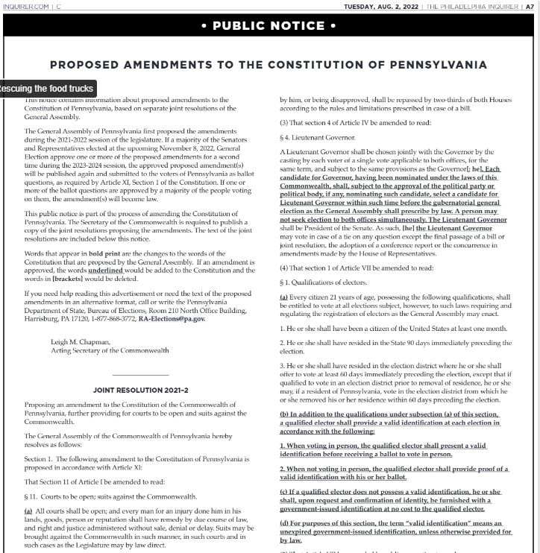
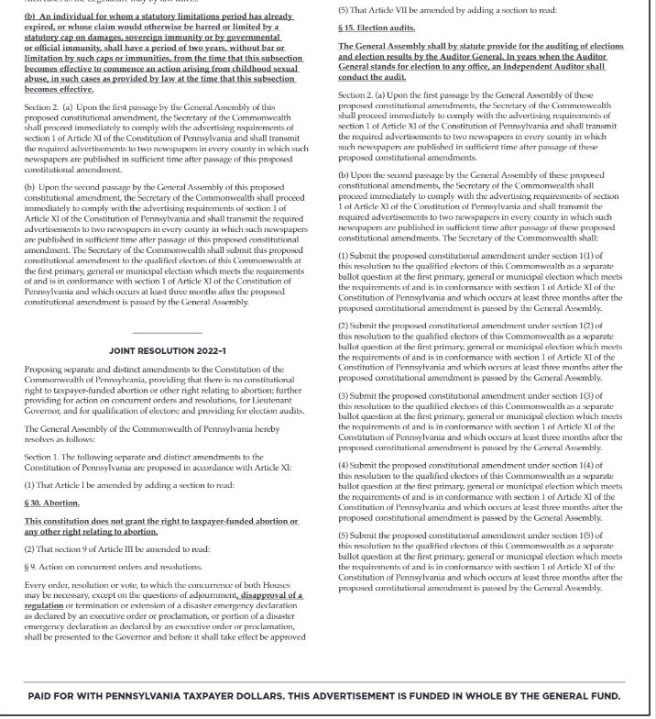
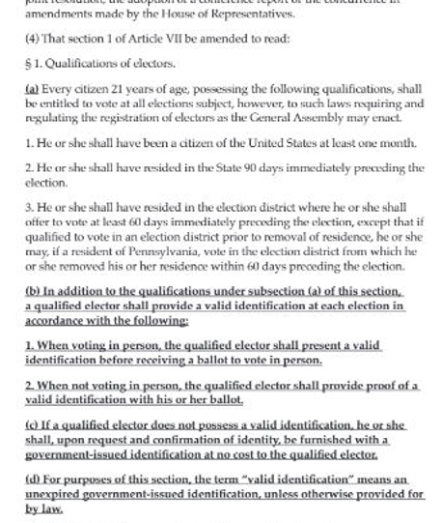
LITIGATION

Slide 14
LINKS and Resources

